Slide 1

Bank Network
Infrastructure Design & Implementation

Slide 2

Bank Network
Infrastructure Design & Implementation
Project Designed & Developed By : Sikandar Ali
Presented By : 23BCS44
Department : Computer Science
University : Quaid-e-Awam University of Engineering, Science and Technology, Nawabshah
Project Supervised By : Ms. Sana Arain (Project Instructor)

Slide 3
Contents
  1. Introduction. .16 Summary
  2. Project Overview. .17 Qna/Ty
  3. Project Objectives
  4. Network Topology
  5. Branch Addressing Scheme
  6. DHCP Services
  7. DNS Server
  8. Email Infrastructure
  9. Wireless Infrastructure
  10. Security features
  11. Dynamic Routing using EIGRP
  12. Administrative Dashboard
  13. Network Testing & Verification
  14. Vlan Implementation
  15 Subneting

Slide 4



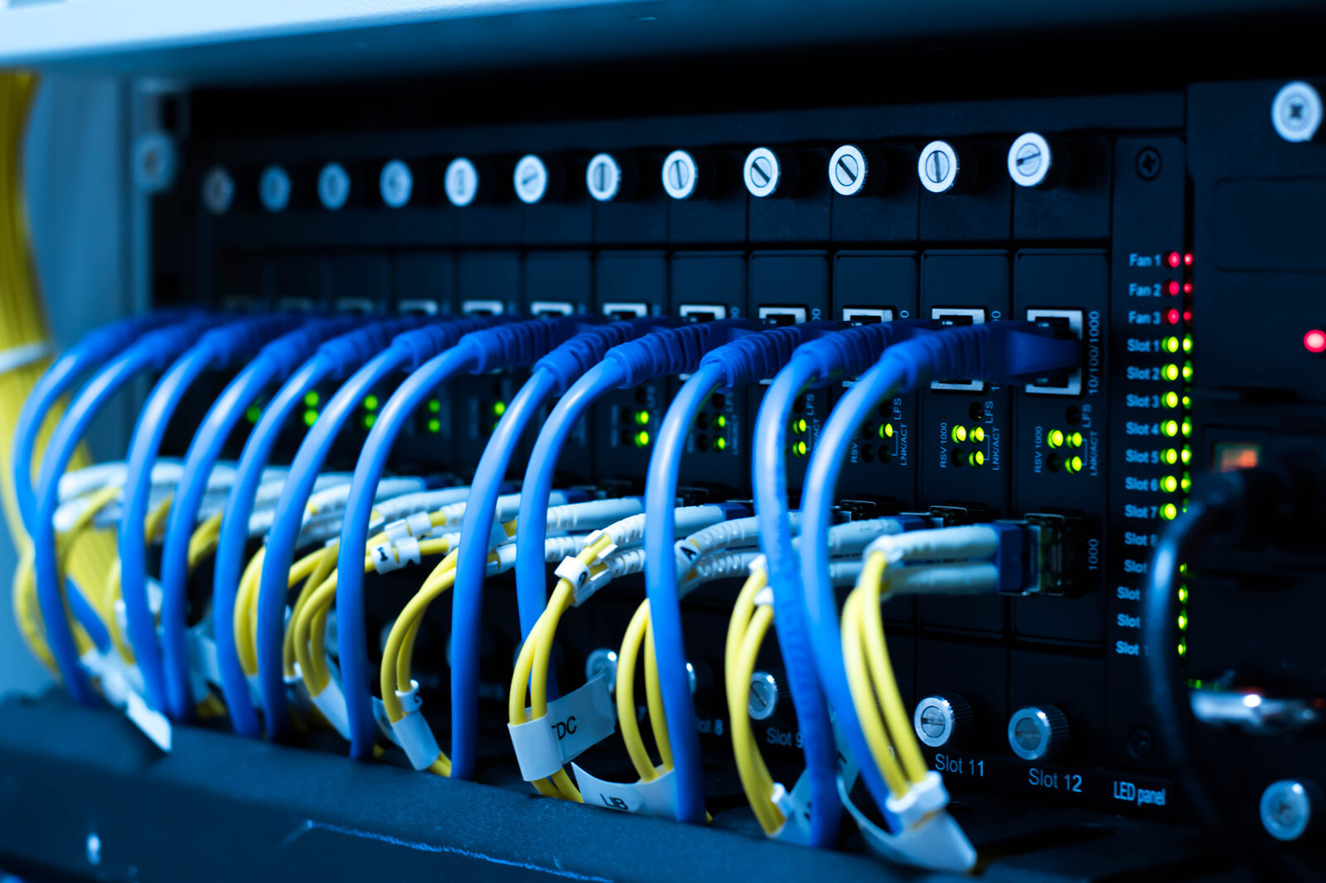
1- introduction
Designed and implemented a secure banking network infrastructure using Cisco Packet Tracer
Simulated an enterprise-level banking environment with a focus on security, reliability, and efficient network management
Configured secure communication, centralized administration, automatic IP addressing (DHCP), wireless connectivity, and protected branch-to-branch connections
Demonstrated practical networking concepts including routing, switching, network security, and infrastructure management using Cisco technologies

Slide 5
2- Overview
Project Title: MyBank Smart Banking Infrastructure | Presented by: Sikandar | Event: International Networking Competition 2026 | Development Tool: Cisco Packet Tracer | What is this project? A secure enterprise banking network simulation with 7 interconnected branches using Cisco technologies | Key Features: 7 Bank Branches, Cisco ASA 5505 Firewall, EIGRP Dynamic Routing, DHCP, DNS & Email Services, Wireless Connectivity (WPA2-PSK), Centralized Administrative Dashboard | Objective: To provide secure communication, automatic IP management, wireless connectivity, and centralized administration in a banking environment | Outcome: A fully functional, scalable, and secure banking infrastructure demonstrating real-world enterprise networking concepts.

Slide 6
3-Objectives & Future Enhancement
Design a secure multi-branch banking network.
Implement dynamic routing using EIGRP.
Configure centralized services (DHCP, DNS, Email, Web).
Provide secure wireless connectivity.
Implement CCTV surveillance.
Implement centralized monitoring using Syslog.
Synchronize all network devices using NTP.
Secure ATM communication using ACLs.
Futture Enhancement:
VPN Connectivity
Dual ISP Redundancy
Intrusion Detection/Prevention System (IDS/IPS)
Cloud Backup
Database Replication
Network Monitoring Dashboard

Slide 7
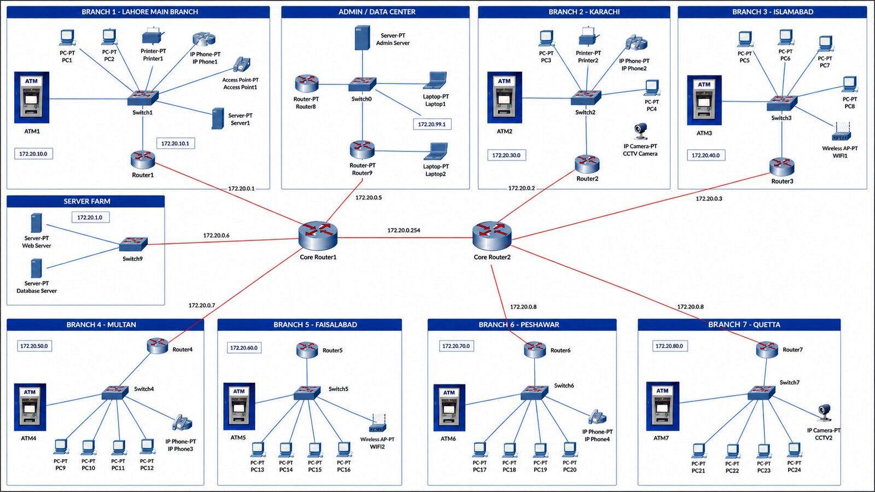
4- Network Modelling
In this Phase we have created a model for network infrastructure that shows network features using (Microsoft Visio) as a modelling tool.

Slide 8
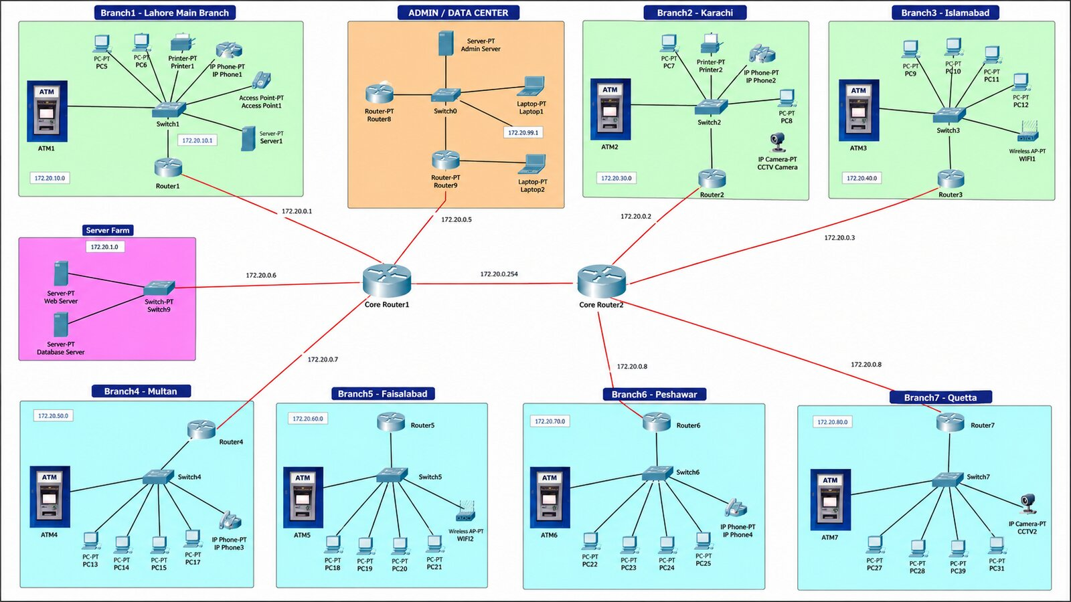
5- Network Topology Design
In this Phase we have created a structured layout of the bank's network infrastructure. This includes defining the logical and physical layout of the network components, such as routers, multilayer switches, access points, servers, and end-user devices.

Slide 9
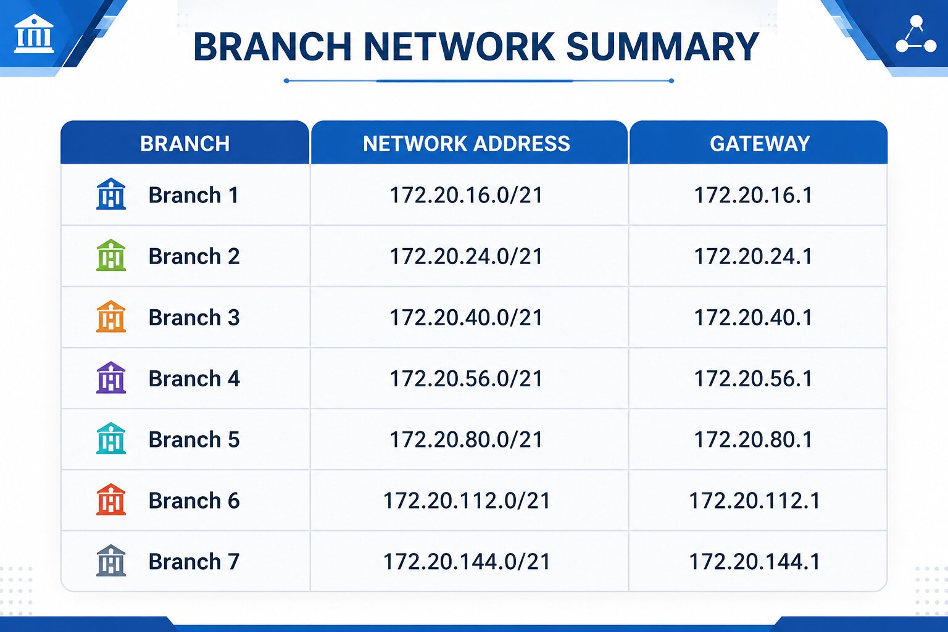
6- branch addressing scheme
In this phase i set up devices for routing and advanced switching. This includes configuring routing protocols, inter-VLAN routing, and security features to enable communication between different network segments securely and efficiently.

Slide 10
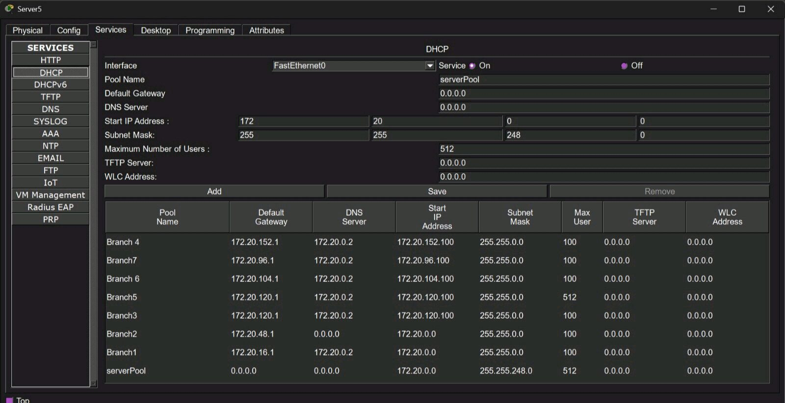
7-DHCP services
To reduce manual configuration, Dynamic Host Configuration Protocol has been implemented.
DHCP automatically provides:
IP address
Subnet mask
Default gateway
DNS server

Slide 11
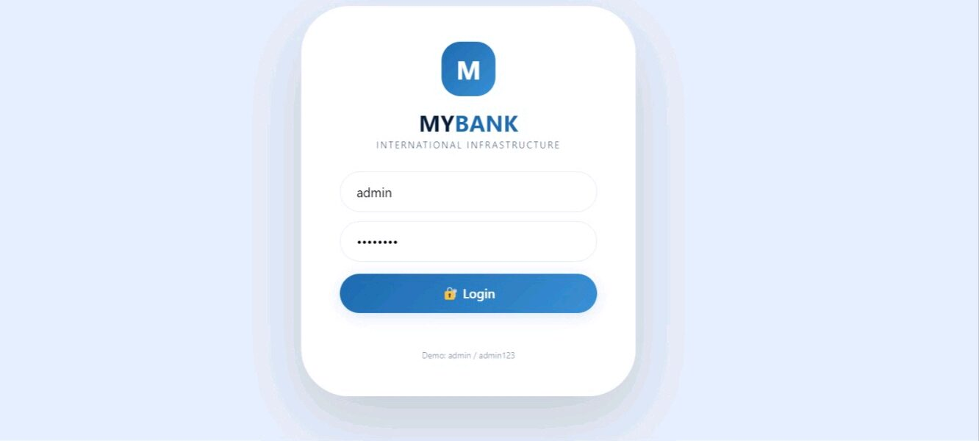
Project Phases
8- DNS Server
IP Address: 172.20.0.48
.mybank.com
· mail.mybank.com
· admin.mybank.com
· Users can simply type mybank.com instead of numerical IP addresses
· Improves usability and simplifies network administration

Slide 12
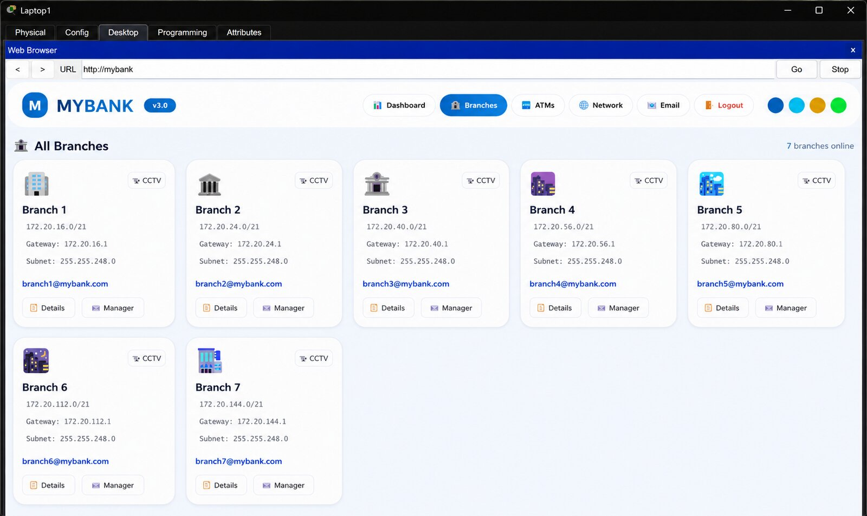

Slide 13
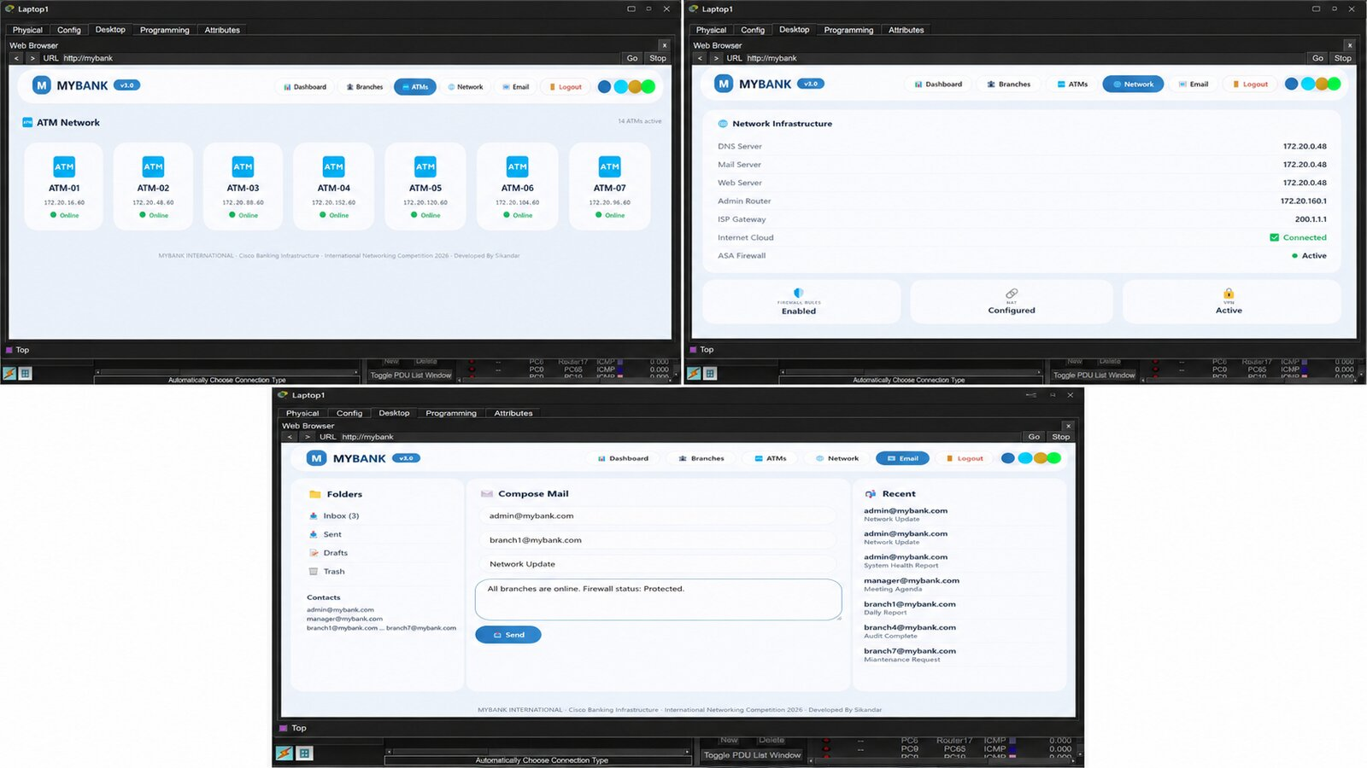

Slide 14
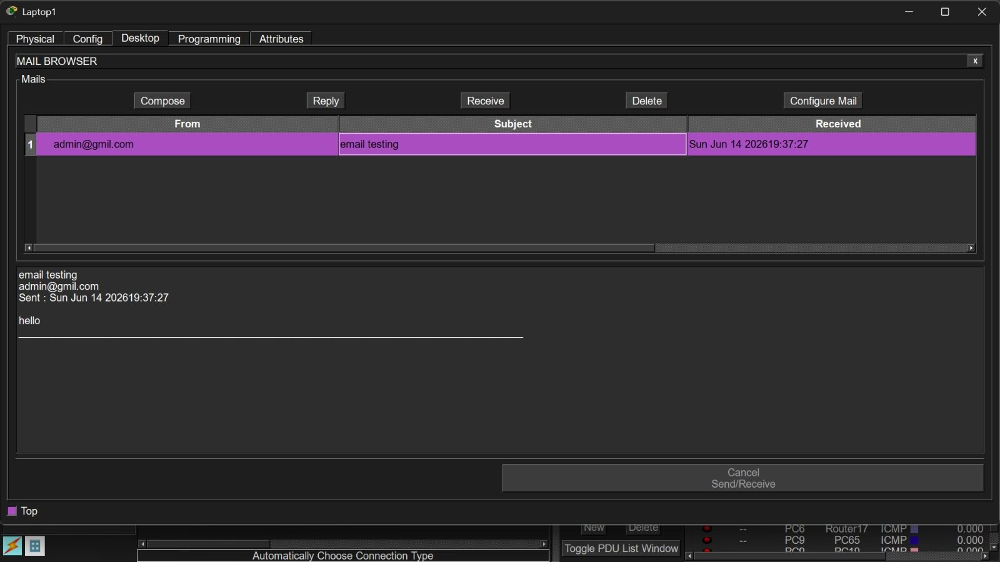
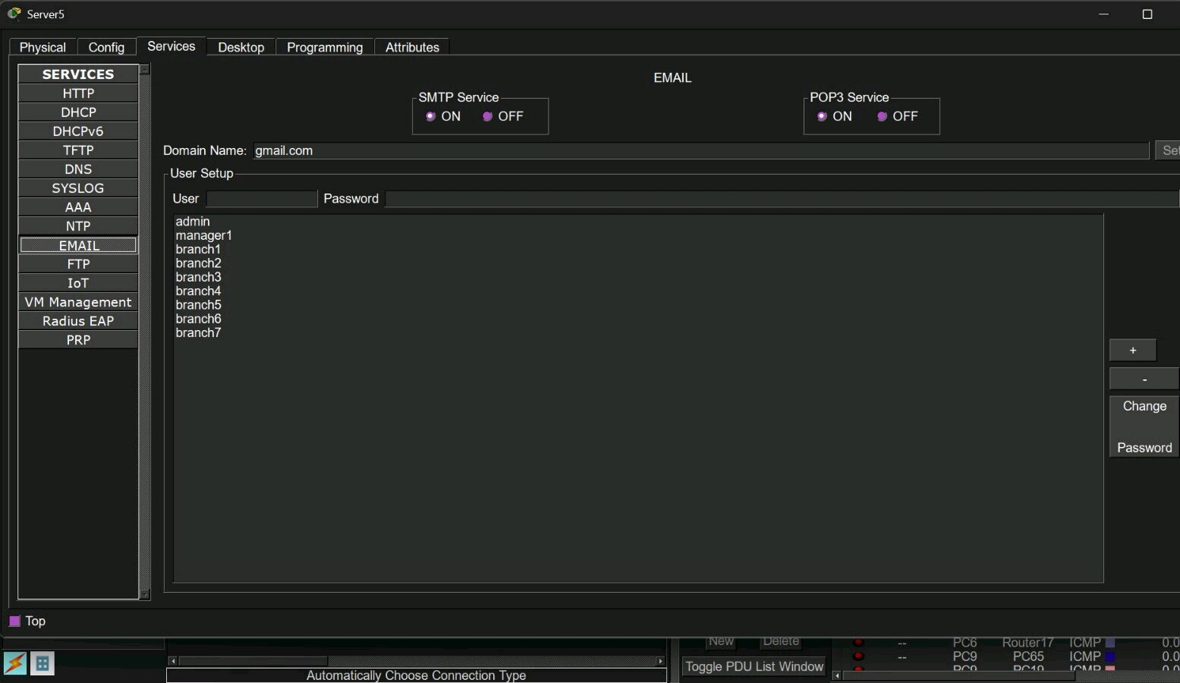
9- Email infrastructure
Email server setup
· Domain: mybank.com
· Administrative Accounts:
· admin@mybank.com
· security@mybank.com
·

Slide 15
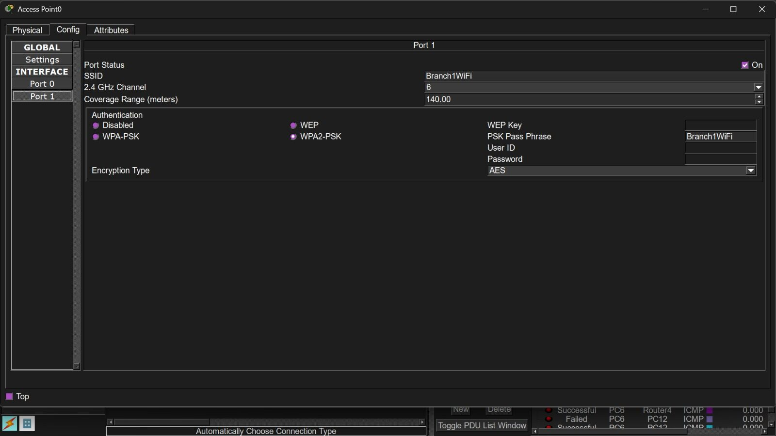
10- wireless infrastructure
SSID: MyBankSecure
· Authentication: WPA2-PSK
· Connected Devices:
· Tablets
· Smartphones
· Laptops
· DHCP enabled for automatic IP
assign

Slide 16
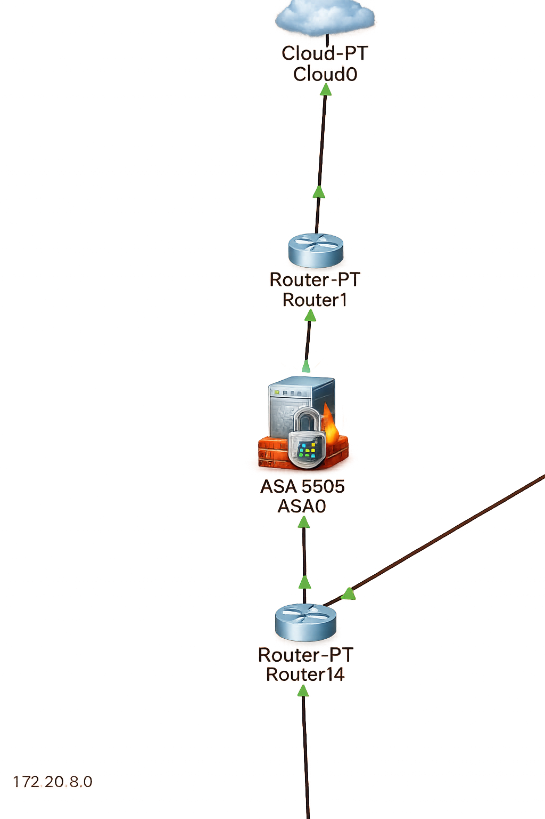
11-Security Features
Device: Cisco ASA 5505
· Outside Interface: 200.1.1.2
· Default Route: 200.1.1.1
· Security Features:
· Access Control Lists (ACLs)
· Traffic Filtering
· NAT (Network Address Translation)
· Perimeter Security
WPA2 Wireless Security
Syslog Logging
NTP Time Synchronization.
ATM access controlled using ACL.
Unauthorized traffic is blocked.
Secure communication with the central banking server.
Centralized transaction processing.

Slide 17
12-Dynamic Routing using Eigpr
Enhanced Interior Gateway Routing Protocol (EIGRP)
Autonomous System Number 100
This project uses EIGRP as the primary routing protocol to establish communication among all seven branches.
EIGRP was selected because it provides:
✔ Fast Convergence
✔ Reduced Network Downtime
✔ Efficient Bandwidth Utilization
✔ Support for Large Enterprise Networks
✔ Automatic Route Learning

Slide 18
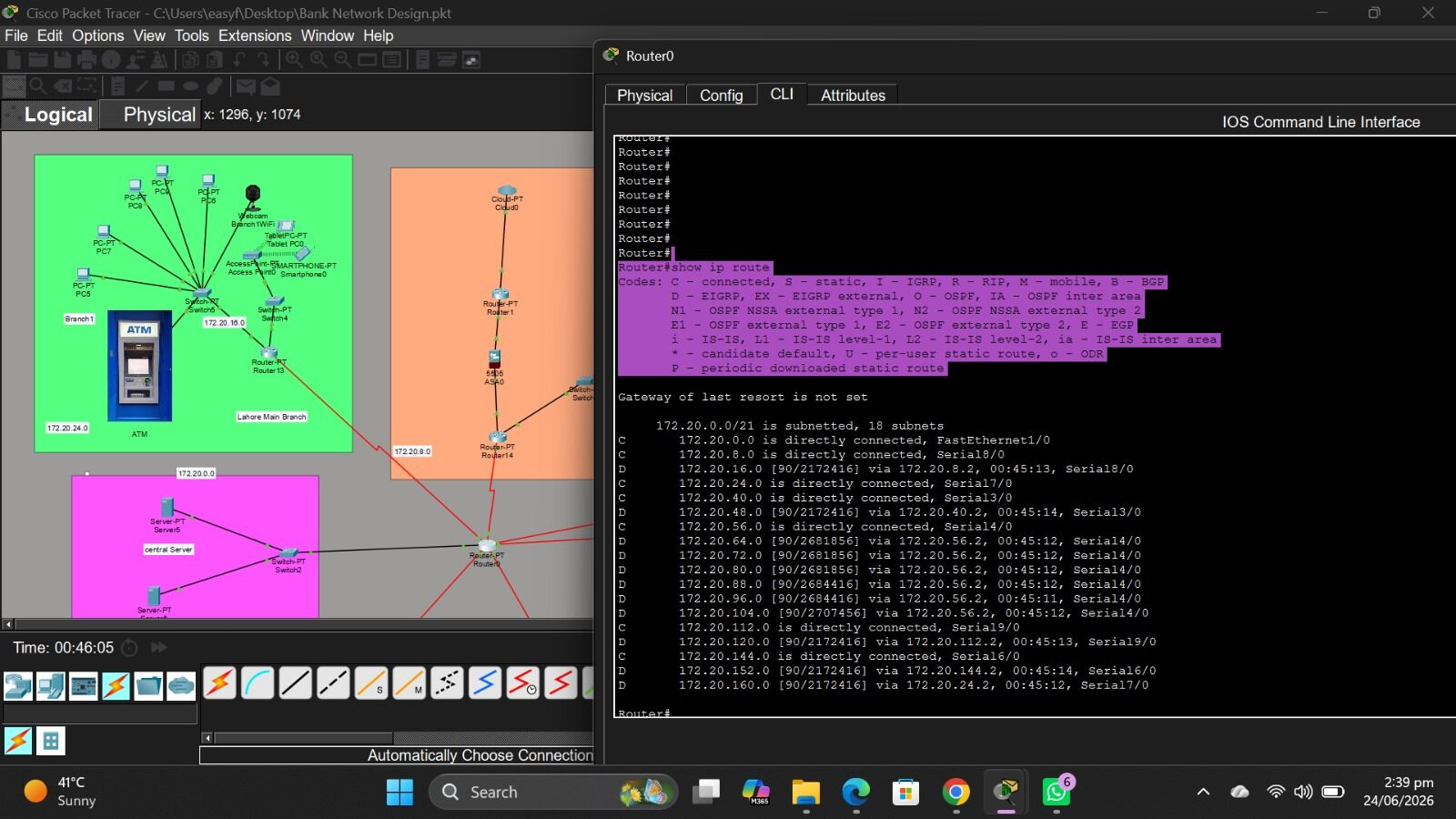

Slide 19
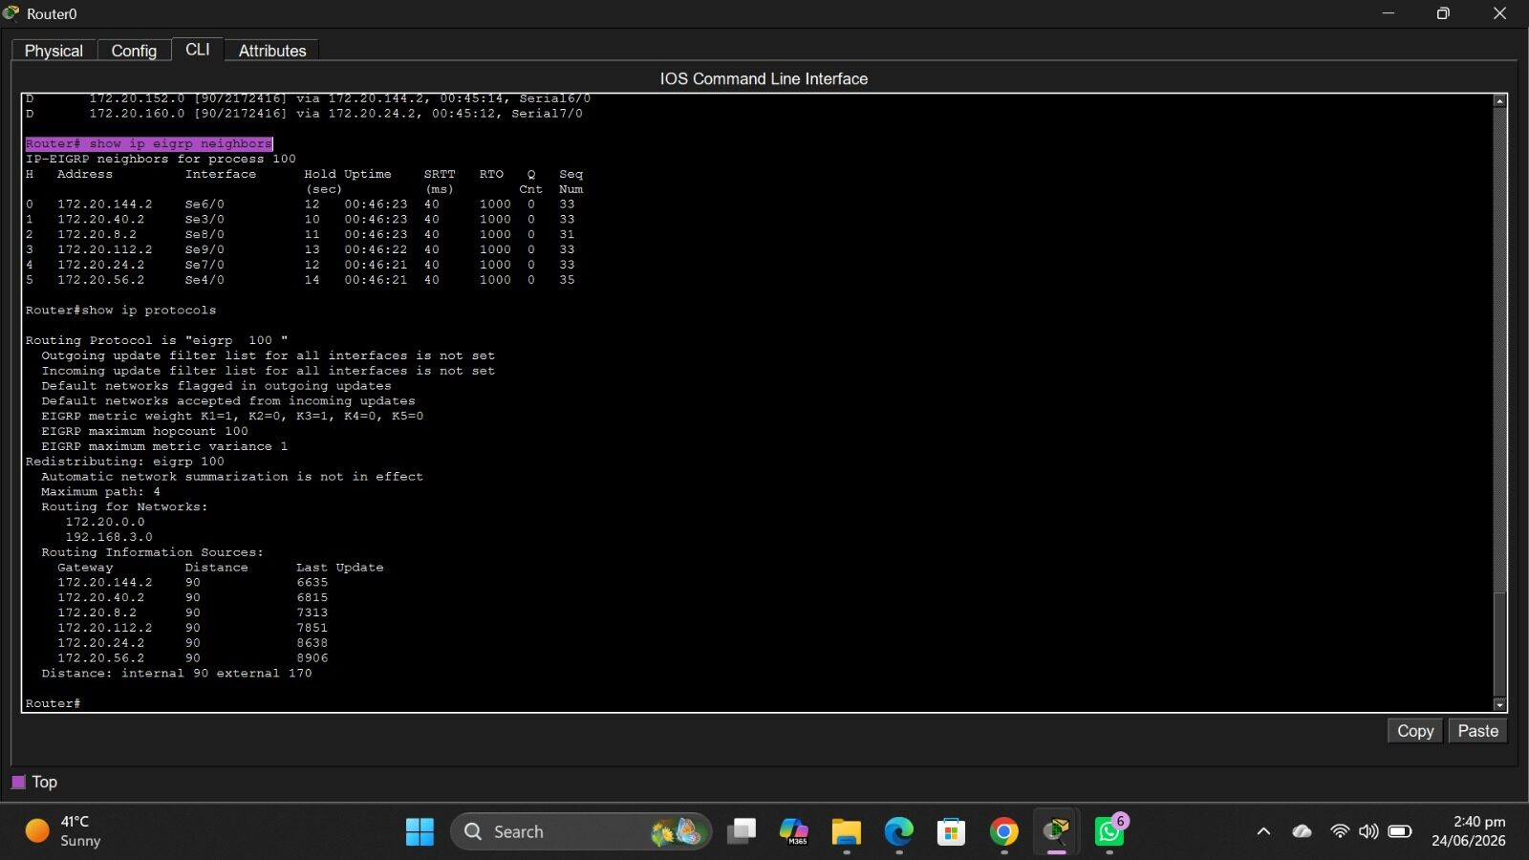
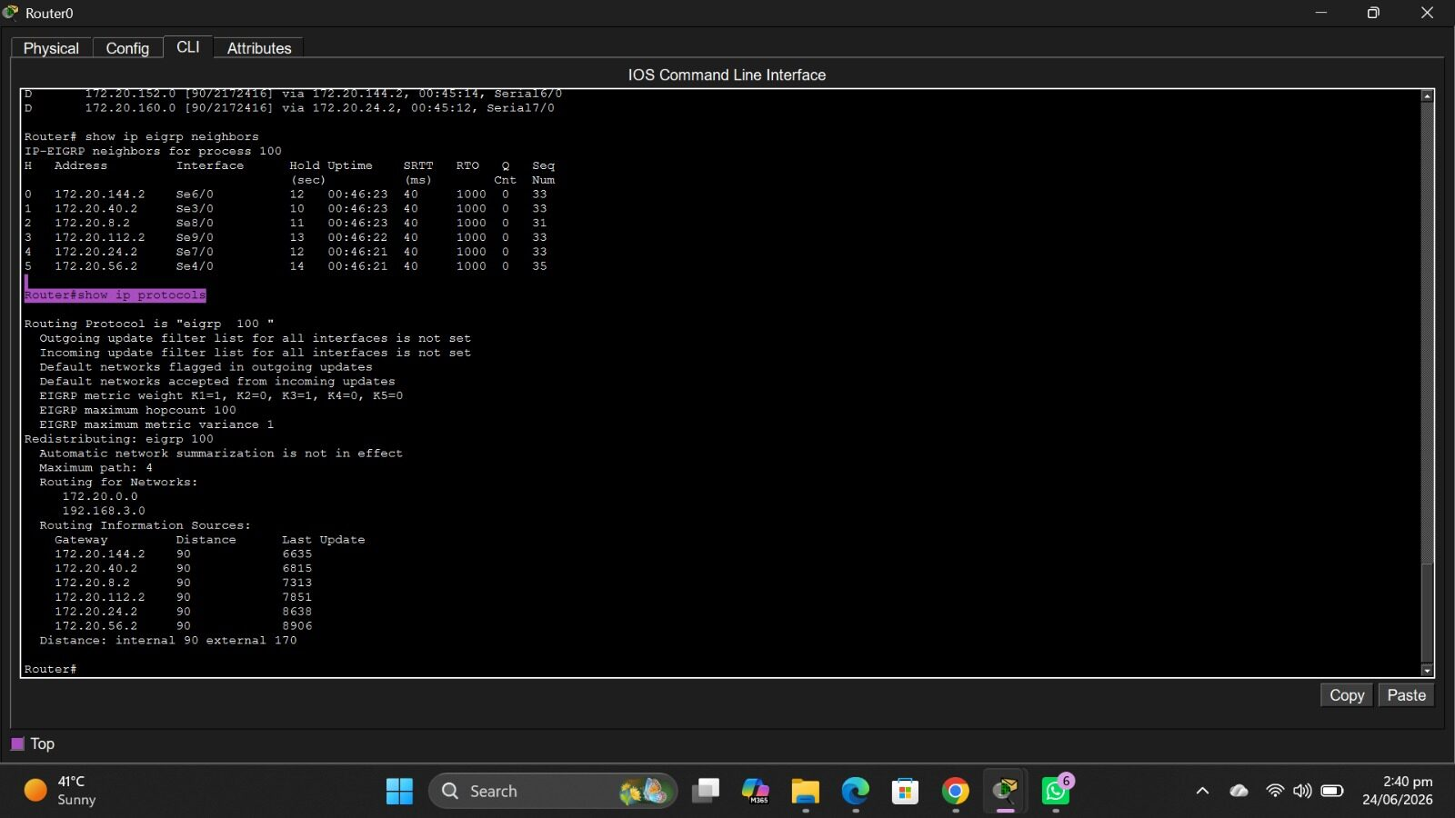

Slide 20
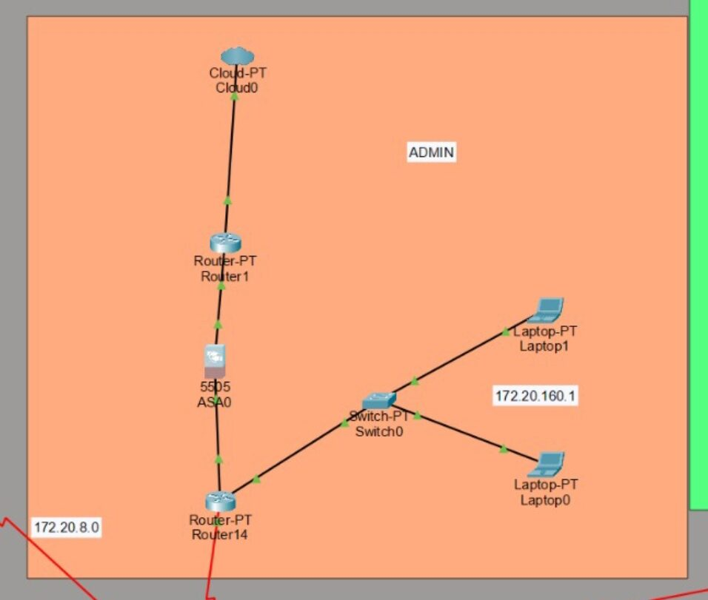
13- Administrative Dashboard
A custom web-based dashboard named MyBank Dashboard has been developed.
Features:
Branch Status Monitoring
Firewall Status
DNS Status
Email Status
Wireless Device Information
Administrative Controls

Slide 21
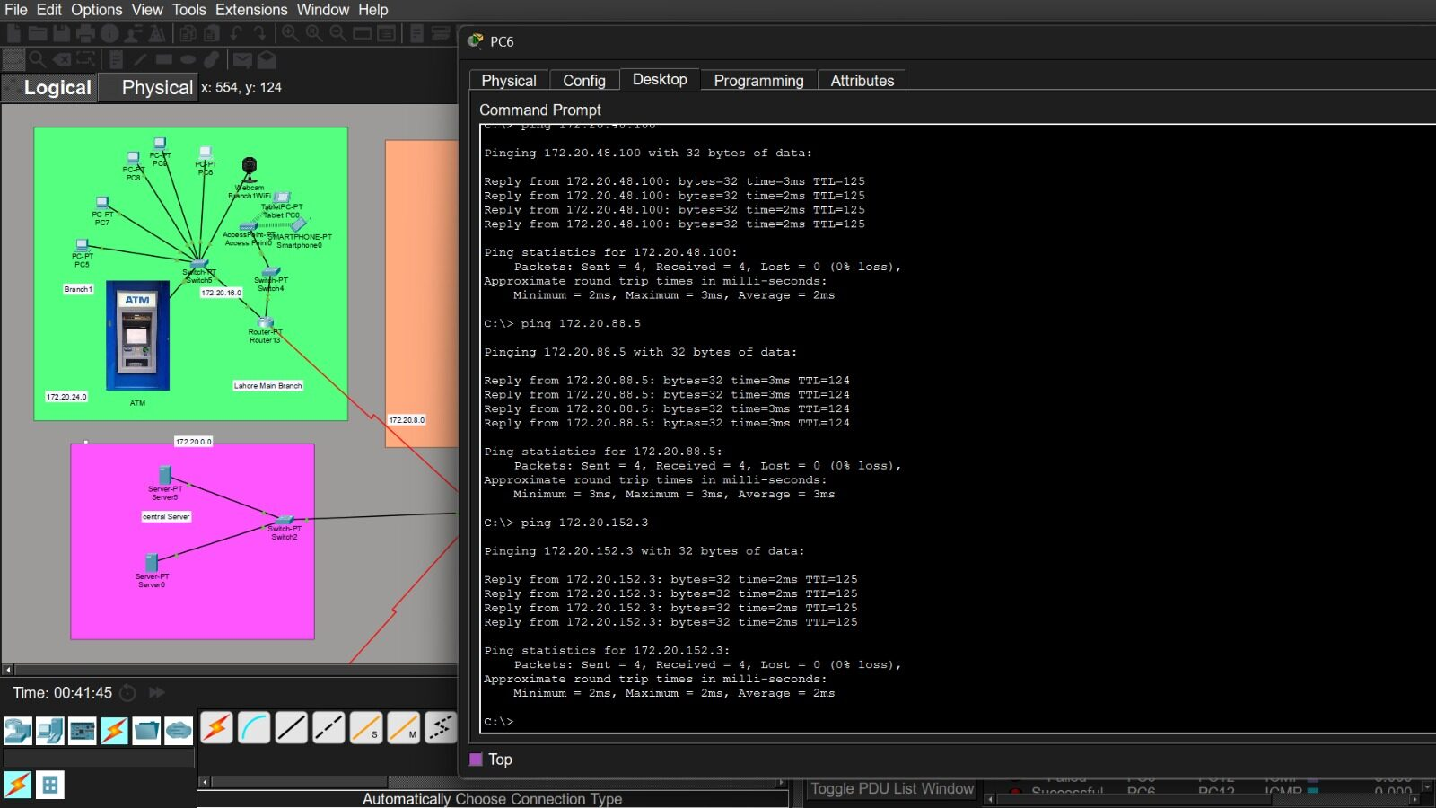
14- Network testing and verification
In this phase i verified the network's functionality, connectivity, performance, and security. Testing ensures all devices communicate correctly, configurations are accurate, and the network meets performance and security standards before deployment.

Slide 22
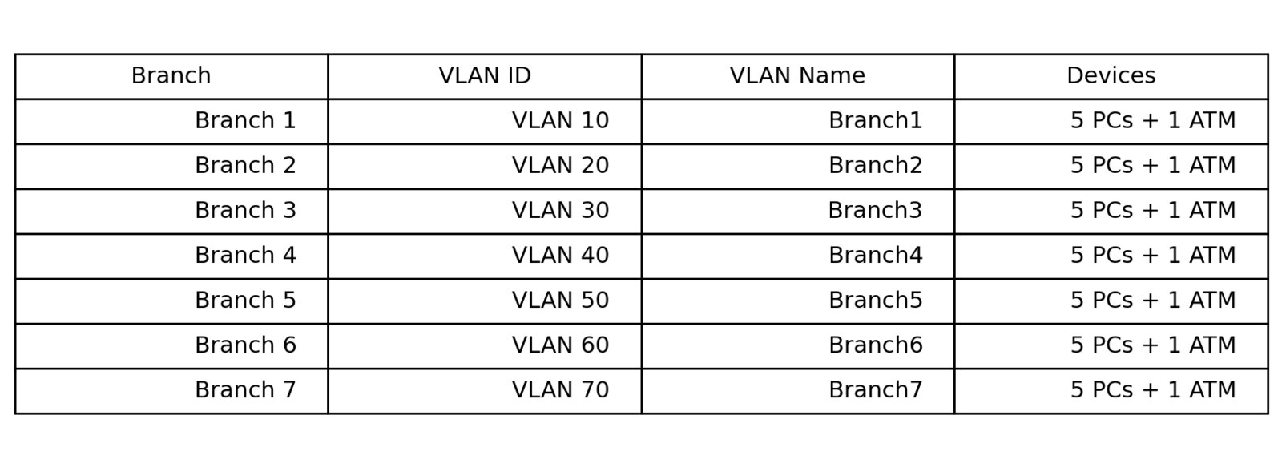
15- VLAN Implementation
A Virtual Local Area Network (VLAN) is a logical network that divides a physical switch into multiple broadcast domains. VLAN improves security, reduces broadcast traffic, and makes network management easier.

Slide 23
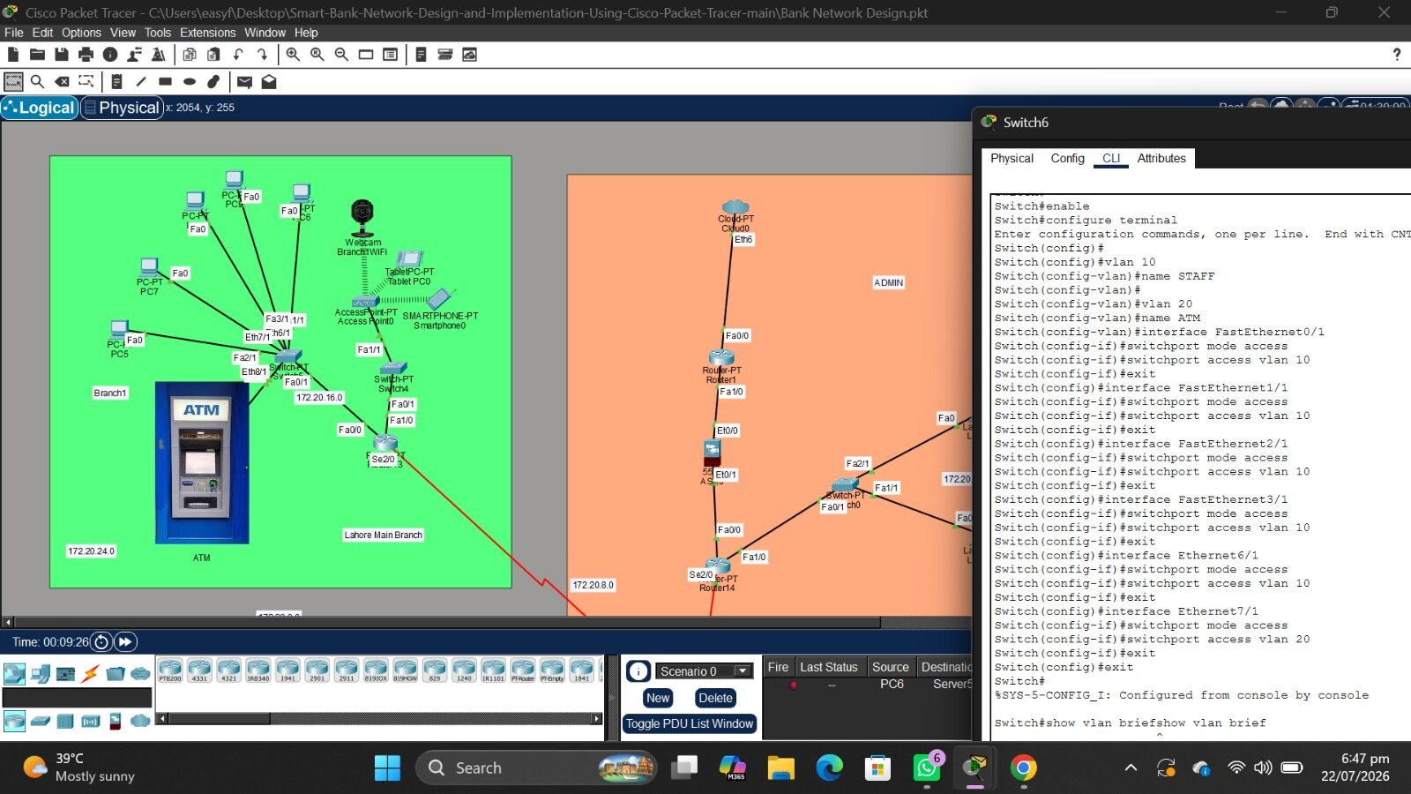
Example (Branch 2)
VLAN Configuration Using Cisco CLI

Slide 24
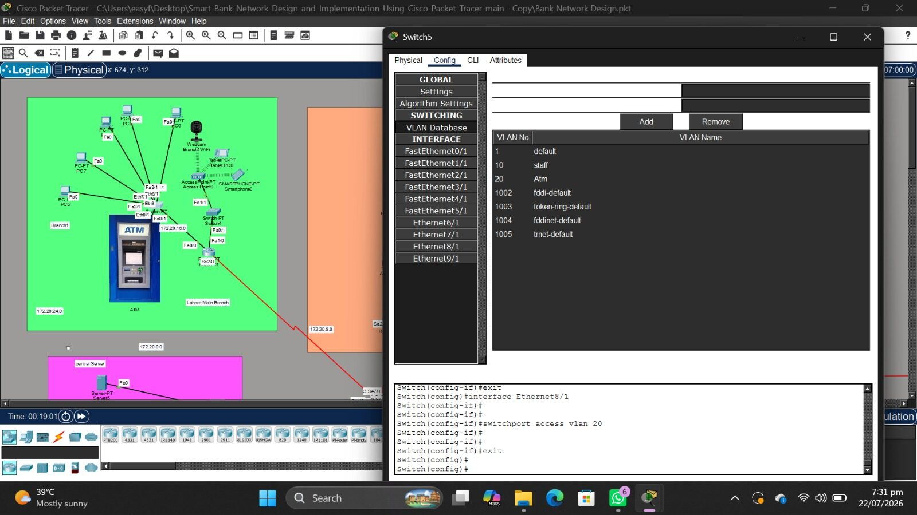
VLAN Verification
The VLAN configuration was verified using the show vlan brief command. The output confirms that all required ports are assigned to VLAN 20 successfully.

Slide 25
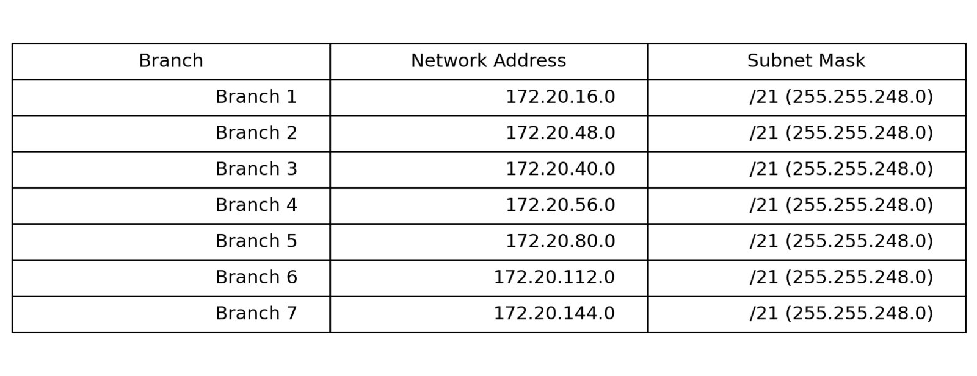
16- Subneting
What is Subnetting?
Subnetting is the process of dividing a large network into smaller logical networks called subnets. It improves network performance, security, and IP address management.
Where is Subnetting Used in My Project?

Slide 26
Why Did I Use Subnetting?
To give each branch its own network.
To reduce broadcast traffic.
To improve network performance.
To make routing easier using EIGRP.
To improve network security.
Why We Use Subnetting
Reduces network traffic.
Improves security.
Better IP address management.
Makes large networks easier to manage.
Limits broadcast domains.
Types of Subnetting
Fixed Length Subnet Mask (FLSM)
Variable Length Subnet Mask (VLSM)
Subnetting in My Bank Project
I used FLSM subnetting because each branch has its own network.

Slide 27

15- Summary
This network infrastructure setup provides a highly scalable, secure, and efficient solution tailored to the bank's needs. It combines advanced routing, secure wireless communication, and robust security measures to protect the integrity and availability of the network.

Slide 28

Any Questions?

Slide 29
Thank You

